Slide 1
Getting Start with Linux

Slide 2
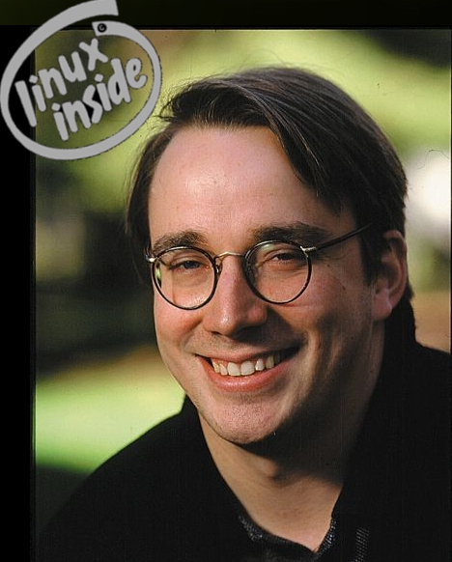
Introduction
Linux is a UNIX-like operating system
Linus Torvalds, who released it to the public, free of charge, in 1991, originally created Linux
Linux offers all the complexity of UNIX at no cost

Slide 3
The Linux Operating System
Linux is a multi-user system, Multitasking system
Portable operating system
Used as
server infrastructure service: Google, facebook
Mobile phone : android
Embeded system: Raspberry PI

Slide 4
Linux Distributions
The distribution is a suite of software for Linux system
Includes:
Kernel
System-installaiton
Management utilities
Program
Examples: Red Hat, Suse, Ubuntu, Debian and many more

Slide 5
Linux Kernel
The core of Linux operating system
Interface to hardware
File system
Process management
Interprocess communication
Protection and security
User can modify and recompile kernel
Kernel can be configured to support kernel module
Kernel module is usually a driver, for example, net work driver, file system driver

Slide 6
Installing Ubuntu 14.04 in Oracle Virtual Box

Slide 7
Ubuntu Installation
In this class we will use virtualization to run Linux
Step
Download Oracle Virtual Box
https://www.virtualbox.org/
Download 64 bit Image
ubuntu-14.04.1-desktop-amd64
Saved in download directory of the local machine
Install Virtual Box
Install Ubuntu Linux

Slide 8
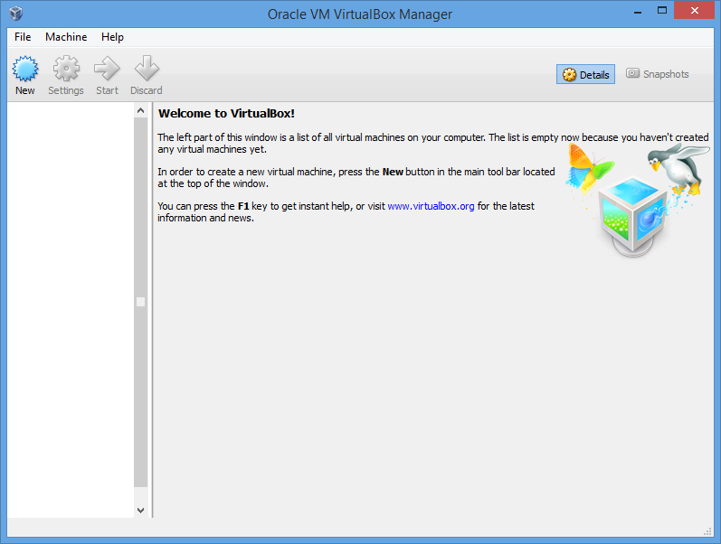
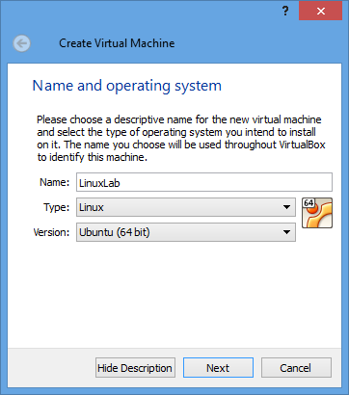
Create New VM in Virtual Box

Slide 9
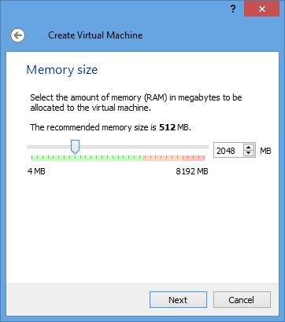
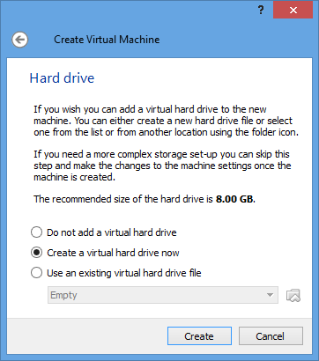
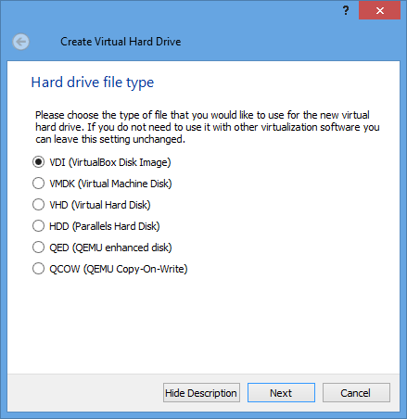
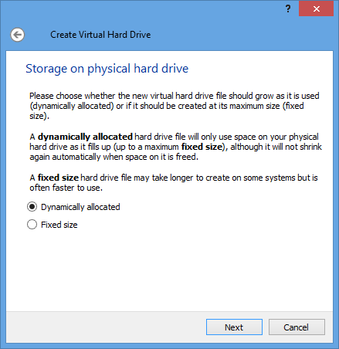

Slide 10
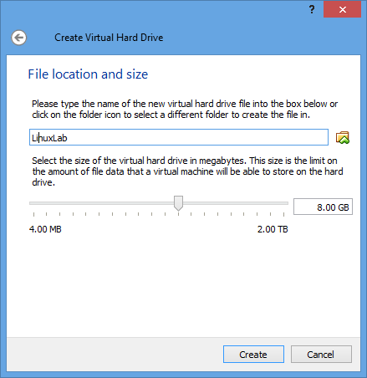
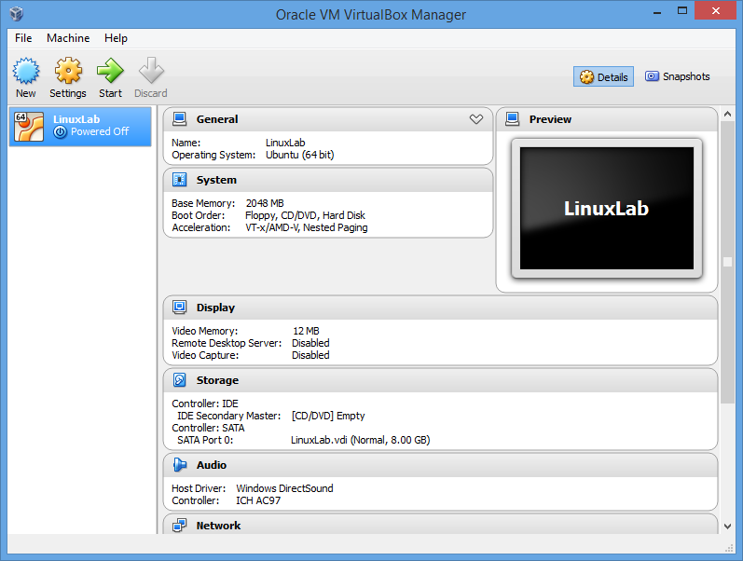

Slide 11
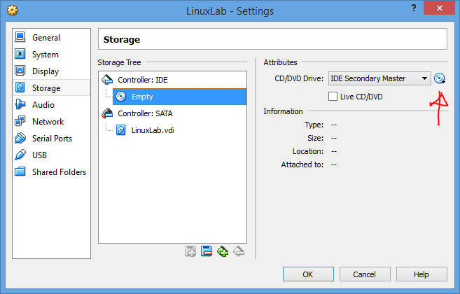
Install Ubuntu OS
Add Image as a virtual CD
Start VM and boot from virtual CD to start the installation

Slide 12
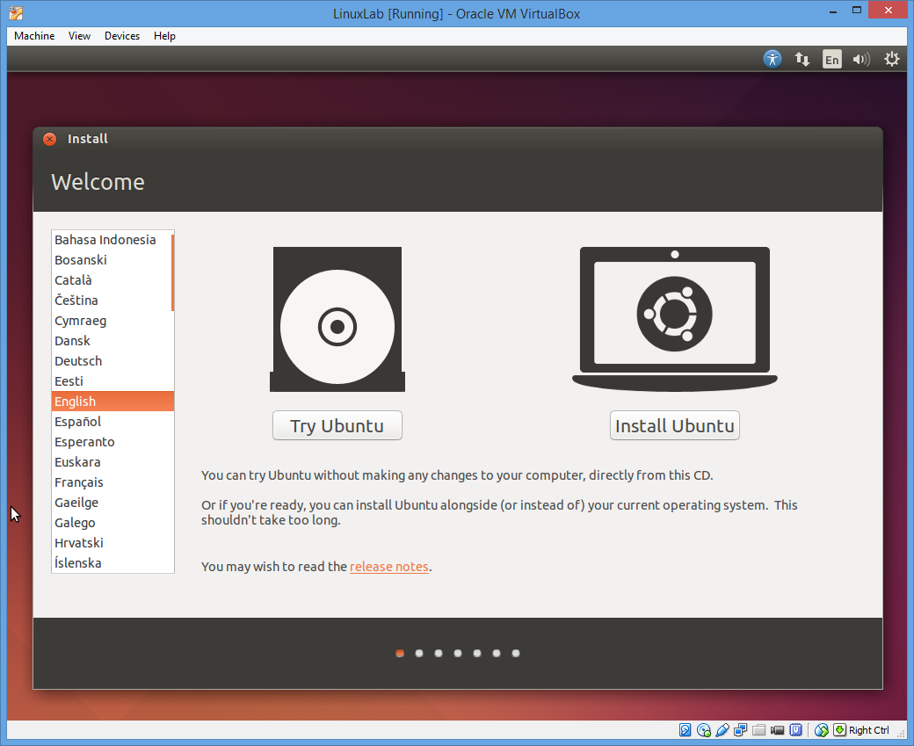
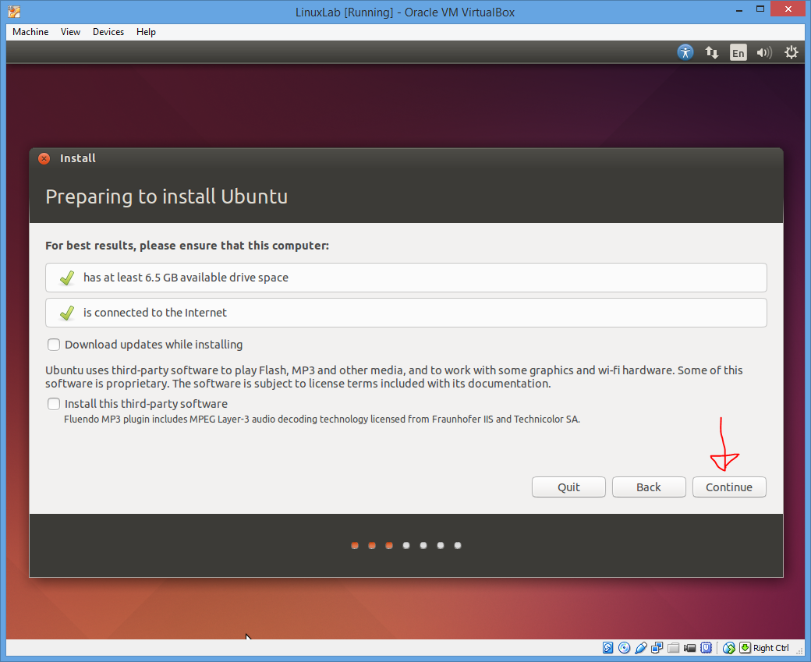
Installation Screen

Slide 13
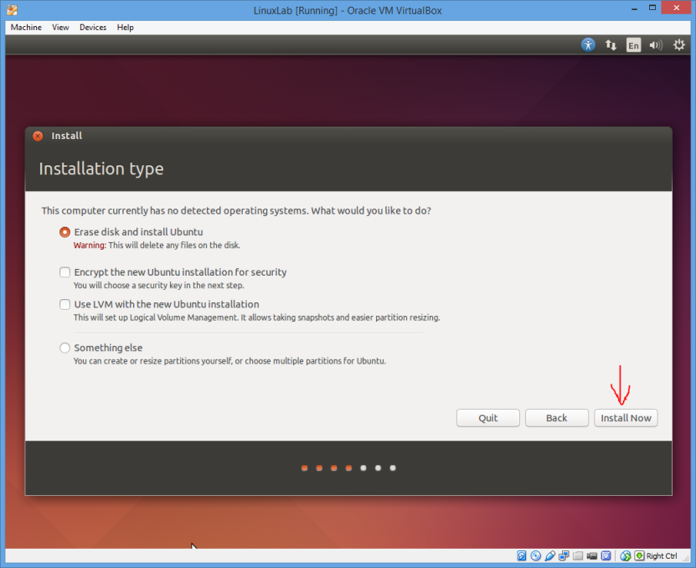
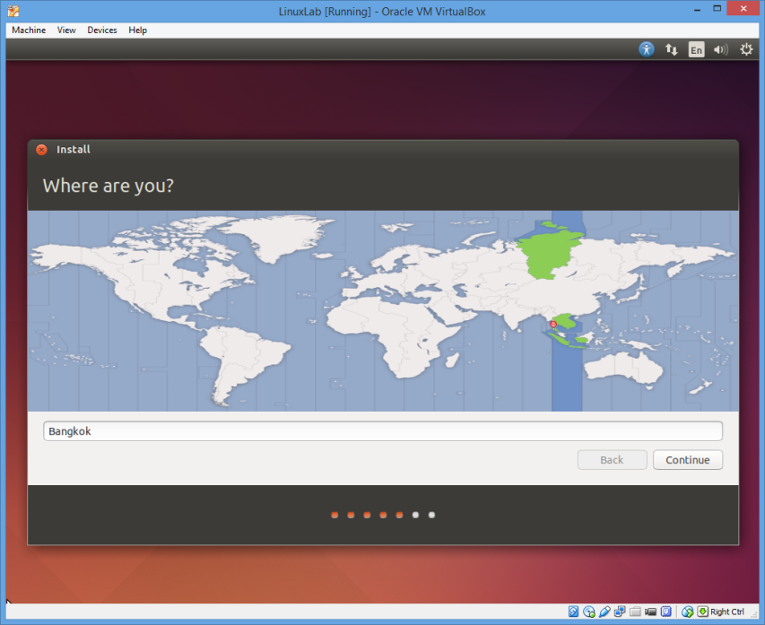
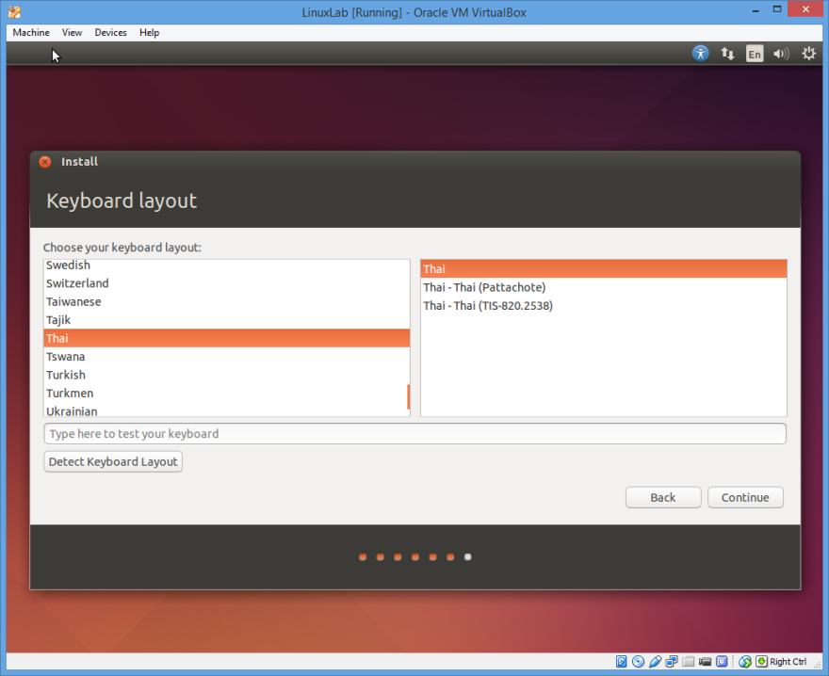
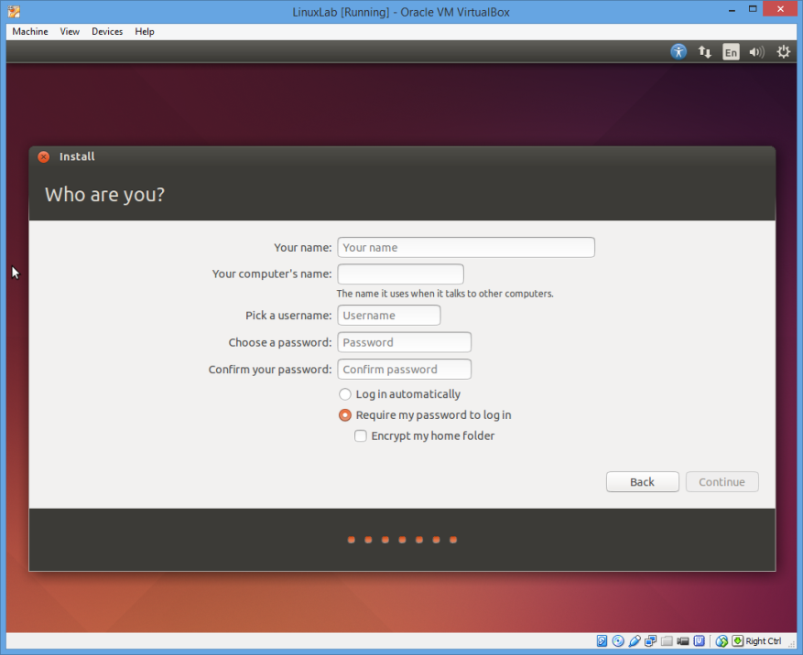

Slide 14
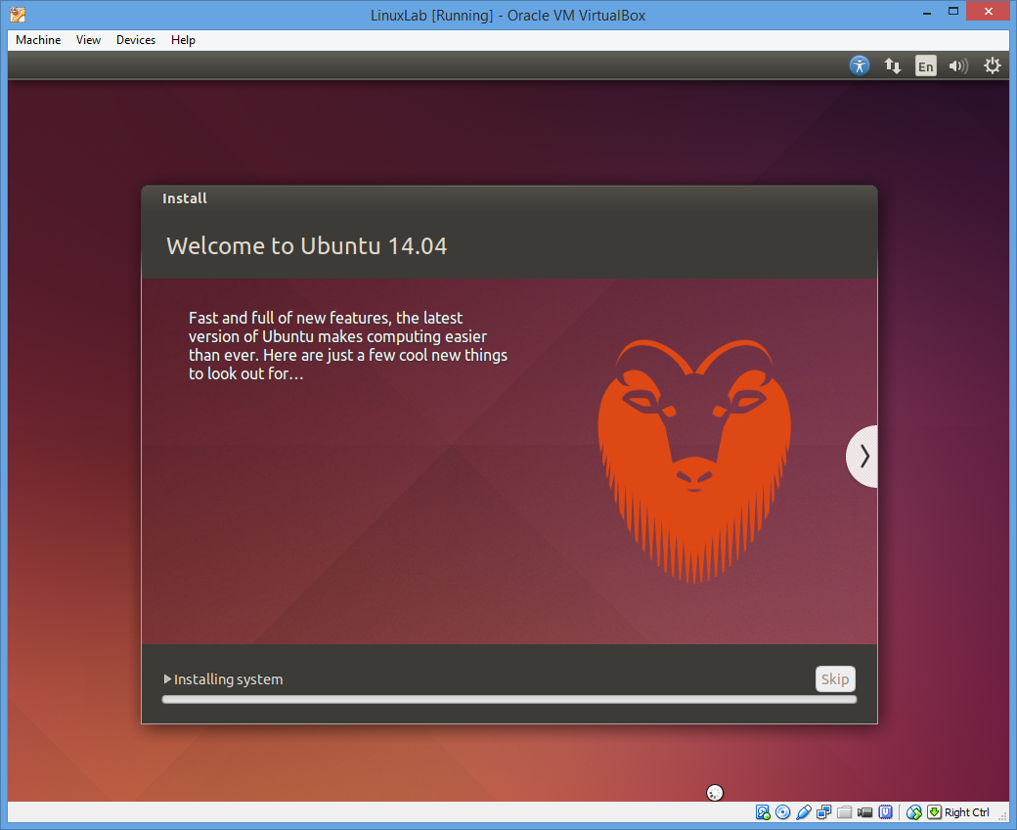
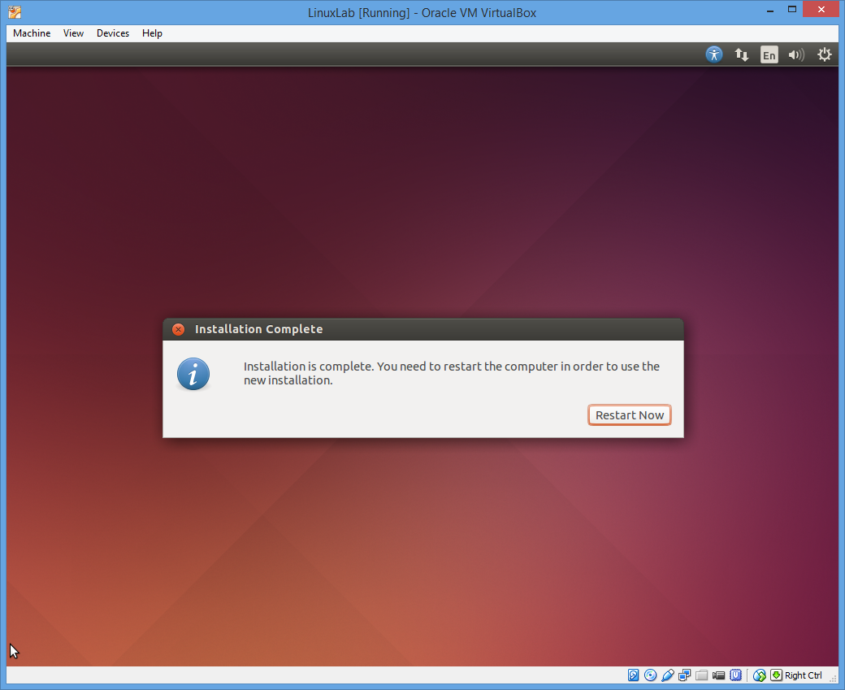

Slide 15
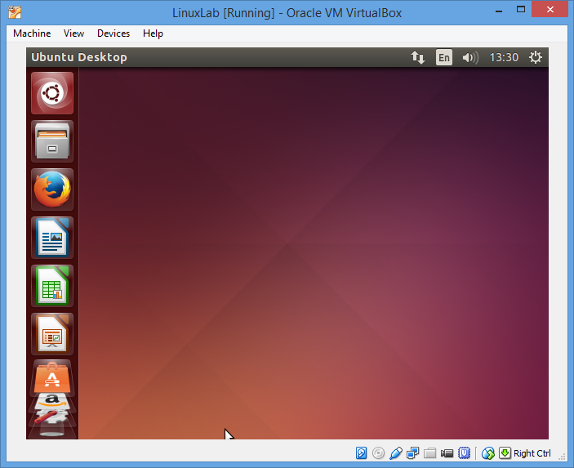
Done

Slide 16
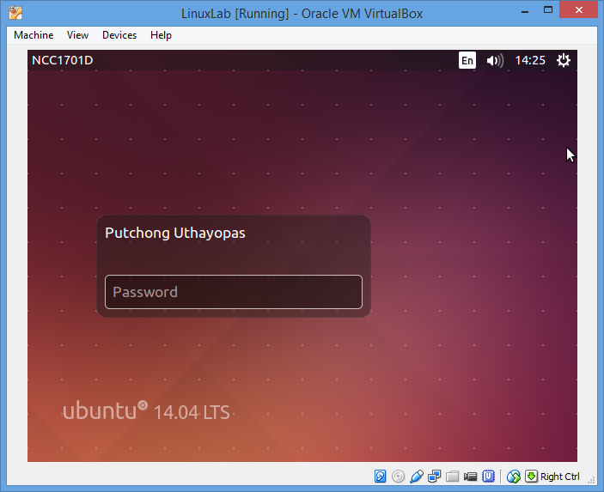
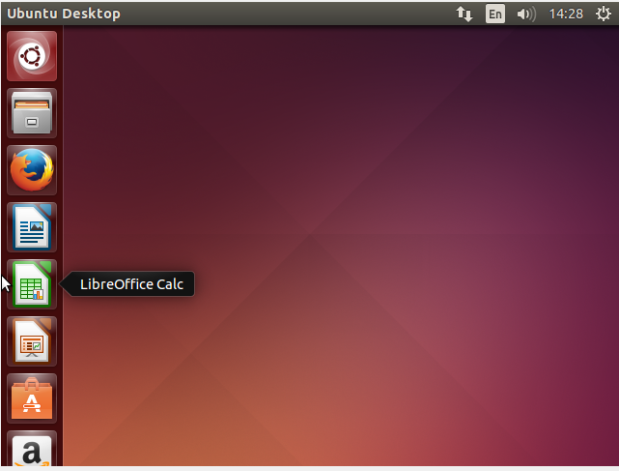
Login to the system
After the installation finish system will reboot
A Graphic Interface screen is presented with login prompt
Use username and password defined at the installation time to login

Slide 17
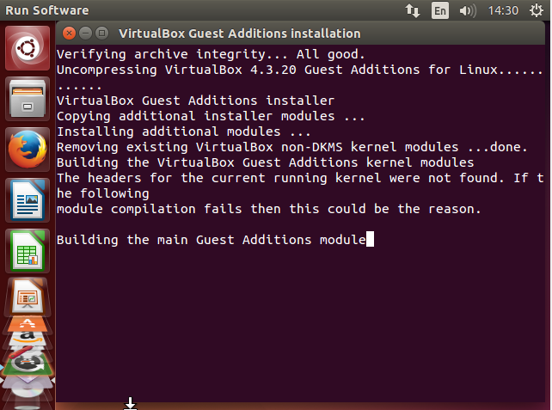
Installing Guest Addition Module
Additional package from Virtual box that help enhanced the Guest VM
Bigger display
More dynamic adjustment

Slide 18
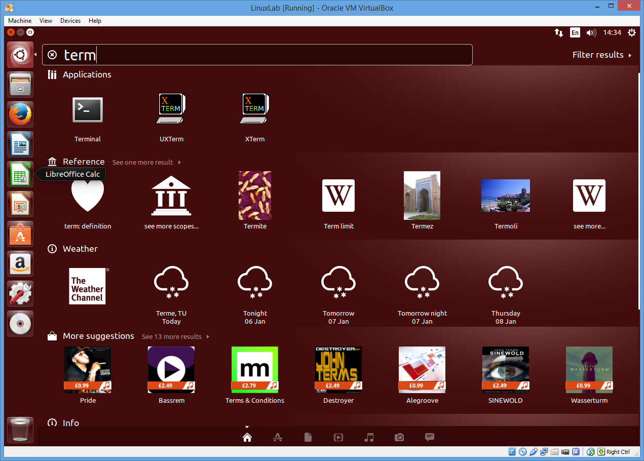
Using Terminal Mode
Terminal can be started using the search tool
We will use a lot of terminal mode in this course

Slide 19
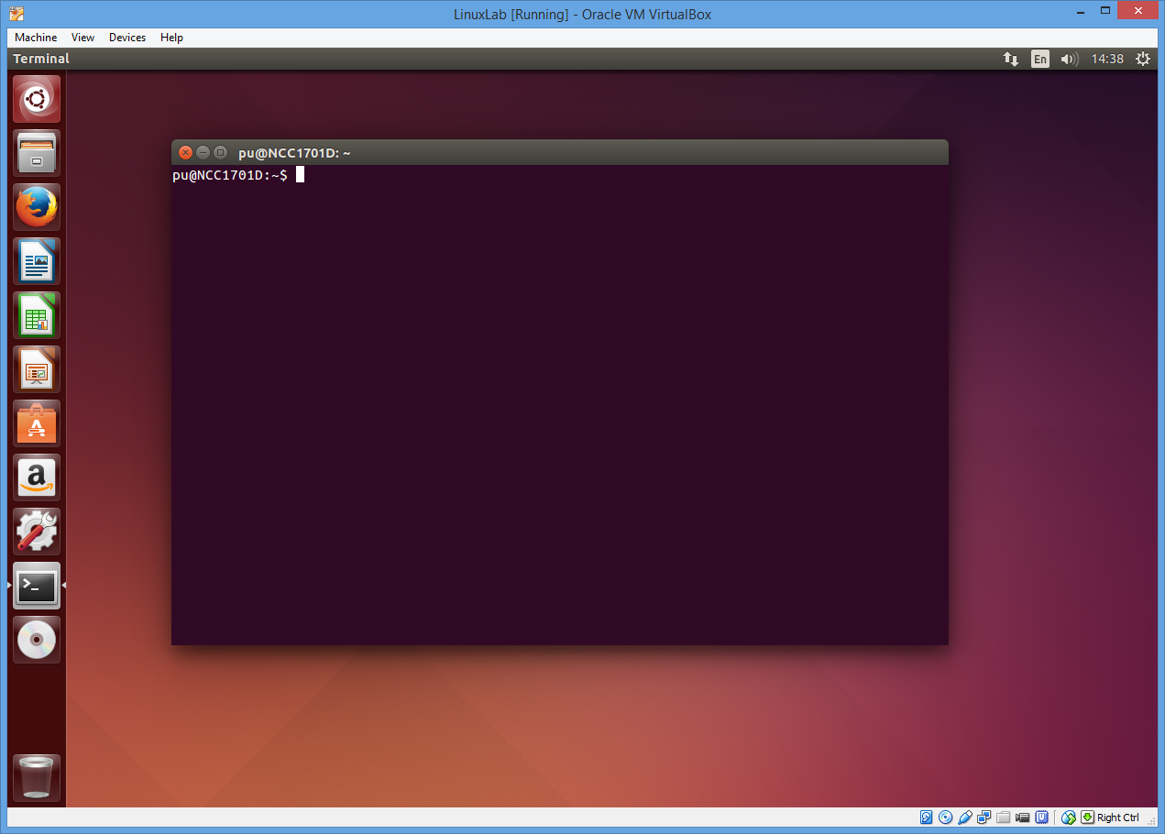
Unix Terminal
Unix terminal is the most common system admin interface to system
Why
Quick remote access over slow network
Low overhead can even run from mobile phone, tablet
Quick debugging for low level system

Slide 20
Basic Linux Command
ls - show list of files in directory
cp - copy file
$ cp file1.txt file2.txt
rm – remove file, delete file
$rm file1.txt ; remove one file
$rm *.txt ; remove all file with extension .txt
$rm * ; remove all file , very dangerous

Slide 21
Basic Linux Command
cat – display content of text file and merge text file
$cat /etc/passwd
cd – change directory
$cd /etc ; go to /etc directory
. means current directory
.. means upper level directory
mkdir – making a new directory
rmdir – remove directory
mv – movefile, rename file
$mv

Slide 22
Process control
Ps – display list of process
$ps display list of process
$ps –ef display all process
Each process have a process id
Process can be terminate using kill command
$kill 243 ; kill process number 243
Kill can be used to send signal to process
$kill -9 243 ; send signal number 9 (“Sigkill”) to terminate process 243

Slide 23
Exercise 1
mkdir dir1
cd dir1
cat > file1 (Enter text, press Ctrl+D when finish)
ls
rm file1
cd ..
rmdir dir1

Slide 24
Tour of Linux System Directory
/bin – programs using at boot time and system maintenance.
/boot – contains the kernel and other files used during system startup.
/dev – represent devices that are attached to the system.
/etc – configuration files that are local to your machine. No binaries are to be put here.
/etc/X11 – X11 configuration files
/etc/skel – skeleton user files, which are used to populate a home directory when a user is create
/home – user home directory
/usr/bin – more linux commands

Slide 25
Linux System Directory (cont’d)
/lib – contain libraries that are needed to execute the binaries in /bin and /sbin. Particularly important for booting the system and executing commands within the root file system
/lost+found – presents once in each ext parition, used by fsck to place orphaned files (files without names).
/mnt – temporarily mounted file systems.
/opt – contains large and static application software packages
/proc – contains special files that either extract information from or send information to the kernel.
/root – usually a root’s home directory
/sbin – binaries executables by root
/tmp – contains temporary files

Slide 26
Linux System Directory (cont’d)
/usr – files that can be shared across a whole site. It can be mount as read-only.
/usr/bin – contain programs for users in the system, for example, vim, pine and so on.
/usr/sbin – contain programs for root in the system.
/usr/include – C language include file
/usr/local – used by the system administrator when installing software locally. It is similar in structure to the /usr directory.
/usr/share – shared configuration for programs in the system, documentations
/usr/share/man – Linux manual pages
/usr/X11R6 – X Window related file

Slide 27
Linux System Directory (cont’d)
/var – variable date files.
/var/log – system log
/var/lib – data files for programs, for example, tripwire, rpm and so on.
/var/spool/mail – default user mail box.

Slide 28
Exercise:
Try to display the content of /proc/cpuinfo. Discuss what you see in this file
Go to /var/log. Guess what file contain output of kernel message at boot time.

Slide 29
Logout and shutdown
To shutdown the system using command “shutdown”
User must be root or the command sudo must be used to make user a system admin temporarily
$shutdown –h now ; shutdown immediately
$shutdown –h +5 ; shutdown in 5 minutes
$poweroff ;shutdown immediately

Slide 30
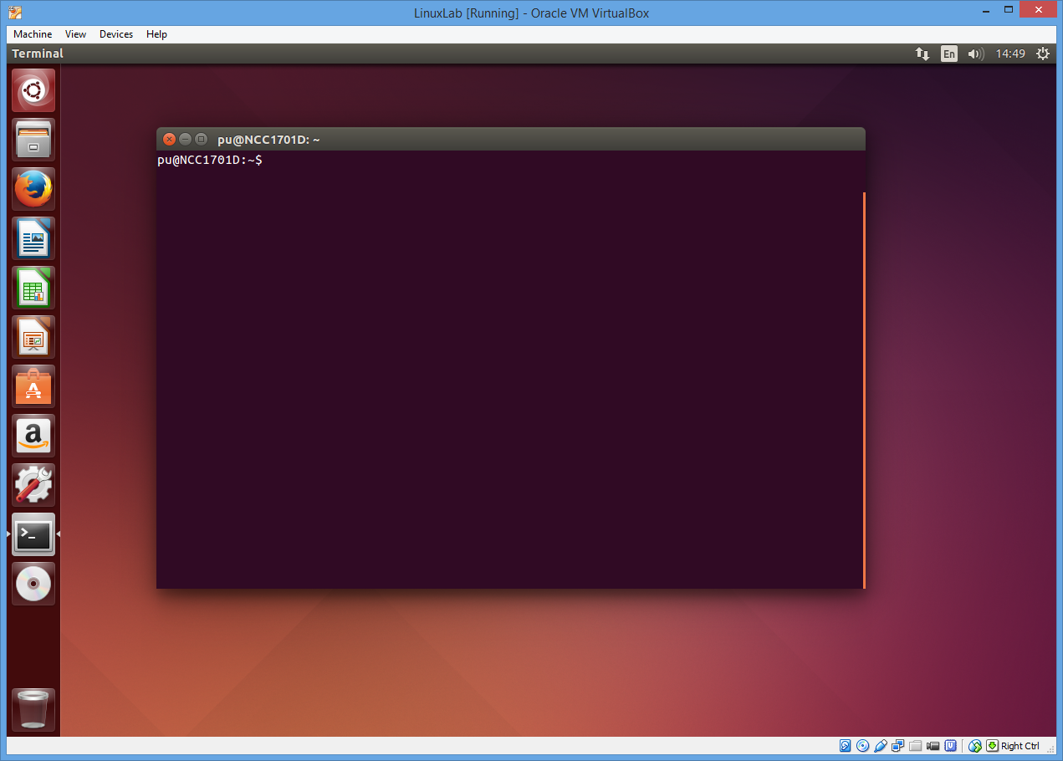
Logging out of the system
GUI is used to logout of the system or shutdown

Slide 31
Module 1
The End

